Slide 1
Basic TouchDesigner Workshop
Creative Coding Utrecht
Raul Leal (Digital Piglet) ｜ 21. 09. 2024

Slide 2
WIFI: ccu
WW: Code03084

Slide 3
Hi my name
Is Raul Leal

Slide 4
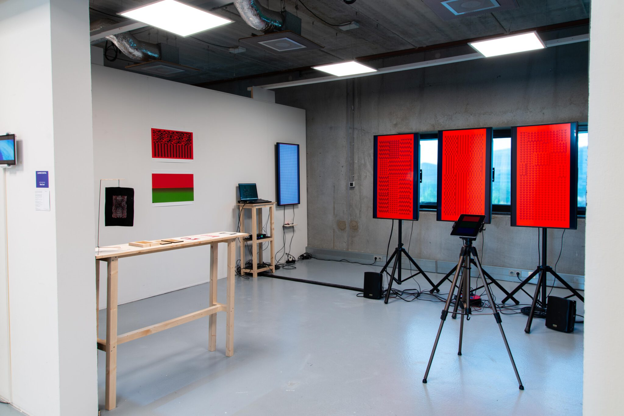
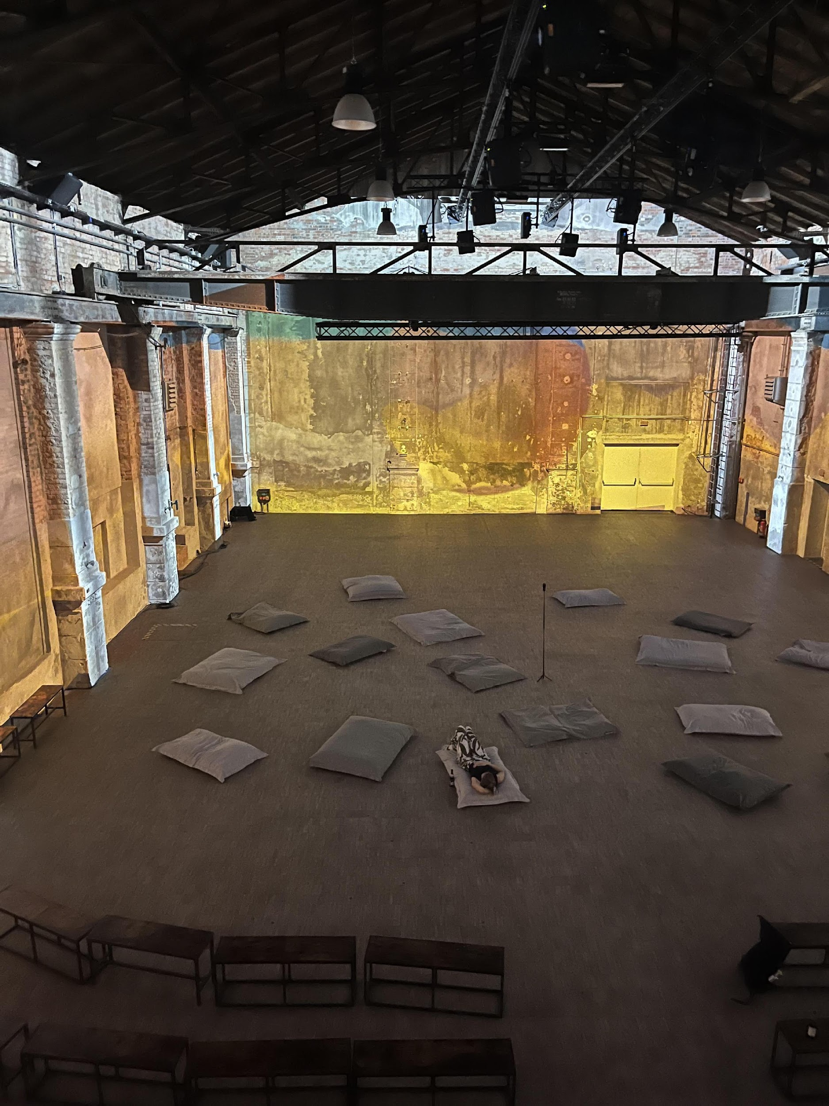
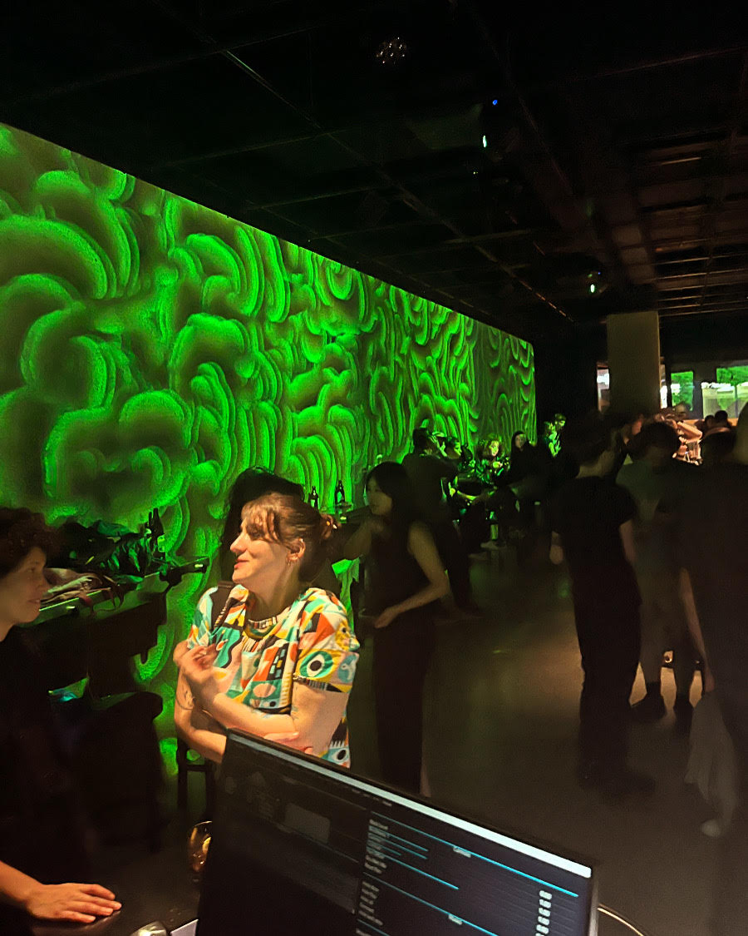
Me
Creative technologist
Rietveld Academy – DogTime Unstable Media
In my practice I aim to use technology as a companion for creation instead of simply as a tool

Slide 5
This workshop
What we will do!
What we will not do
Basic Introduction
  Programming with TD
  Common useful logic patterns
  Assigning references
Bauhaus typography motion graphics
Make as much as you can
Have fun
No 3D
No Particles
No Kinect

Slide 6
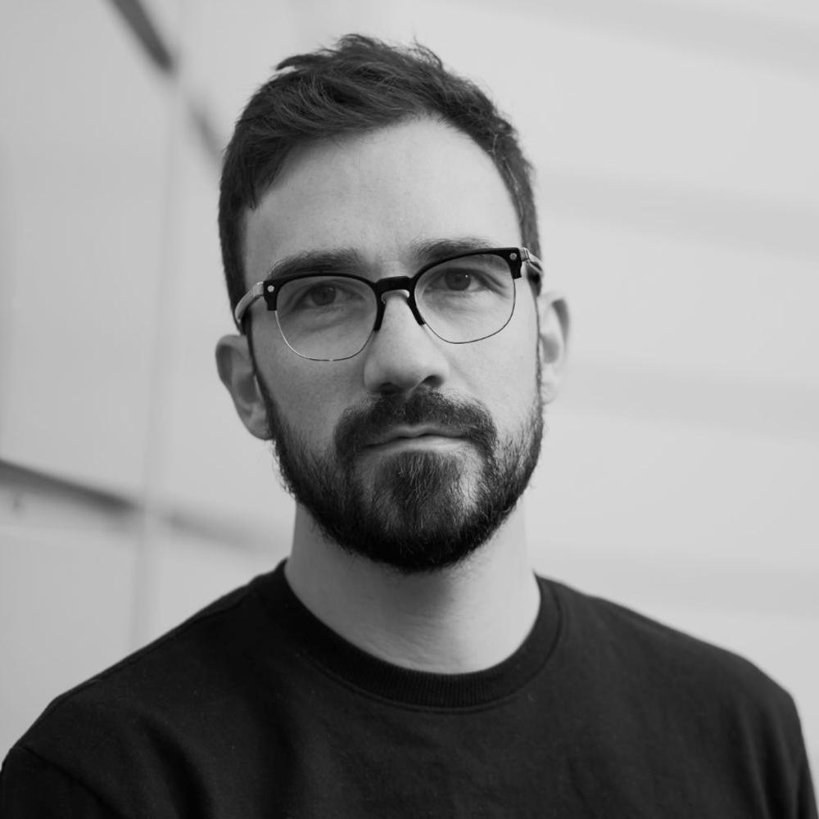
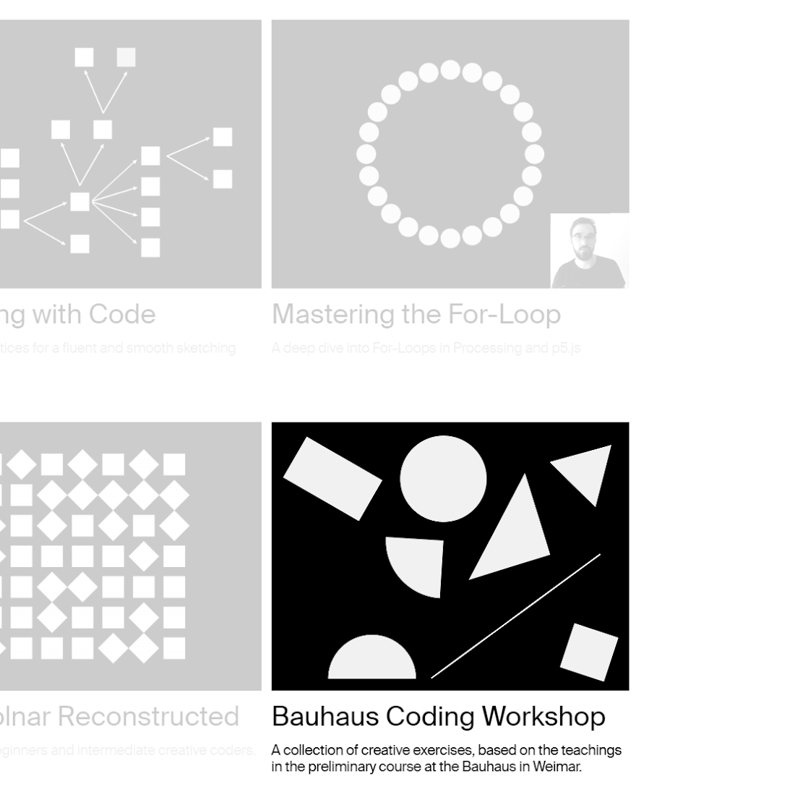
Tim Rodenbröker

Slide 7
Risepad
https://pad.riseup.net/p/hku_basic_td_workshop_feb_2026

Slide 8

Constraints for the workshops…
It is done in
TochDesigner and...
Only uses...
Only uses...
It is an interactive 2d animation,
i.e. no 3d scenes, objects etc..

Slide 9

Workshop Structure
Intro
Make them move
Make them audio reactive
Draw things
Add logic to the movement

Slide 10
Two main principles…
TouchDesigner is a programming language…
…It requires a “different” mindset

Slide 11
In a nutshell…
Node based programming language
  Essentially function composition f(g(h(x)))
Very good for making data into visuals (not scientific)
Very good for sensor data and sending it back to devices
Not good at making sound – go to Ableton or Max
  Good to orchestrate midis though

Slide 12
Let’s Begin!

Slide 13
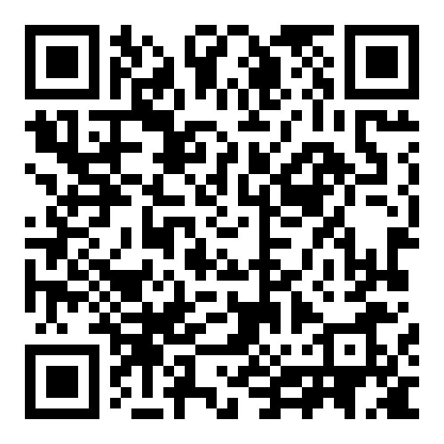
Git repository
https://github.com/Rauleal/TouchDesigner_Bauhaus_workshop

Slide 14
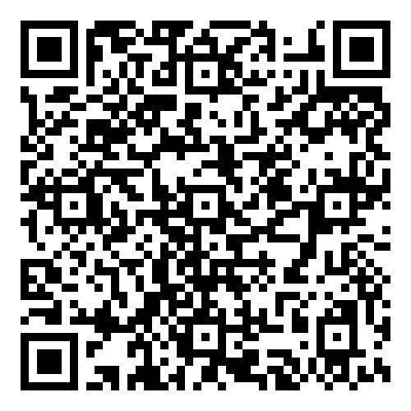
YouTube channel
HTTPS://WWW.YOUTUBE.COM/WATCH?V=AMGKNHYQ4O0&LIST=PL3ZGSOEHGDIR5X5BIG8E8YN2BQMBQ6IGB

Slide 15
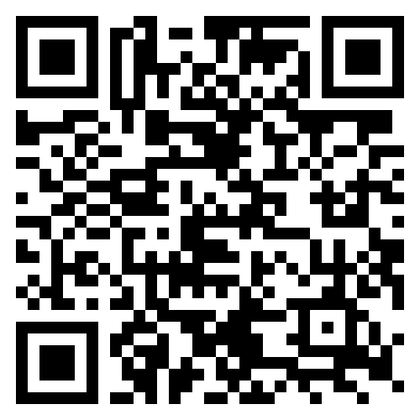
TouchDesigner
Documentation
HTTPS://DOCS.DERIVATIVE.CA/MAIN_PAGE

Slide 16
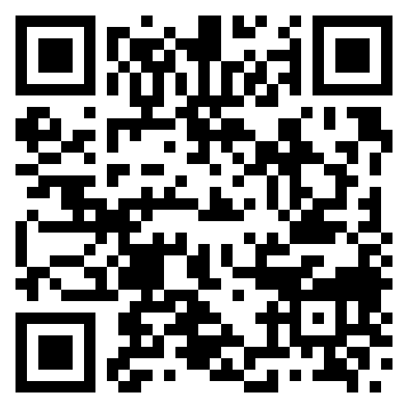
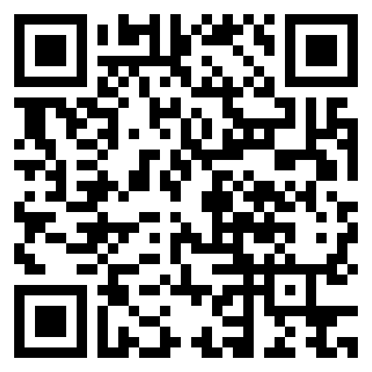
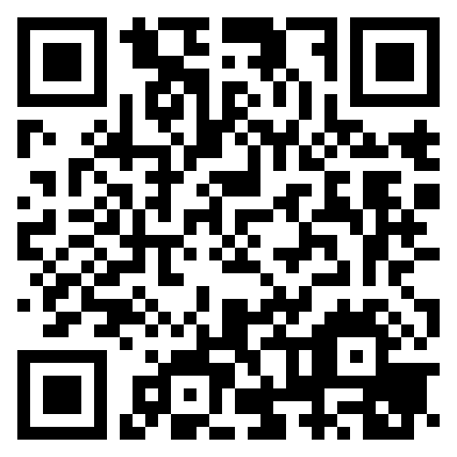
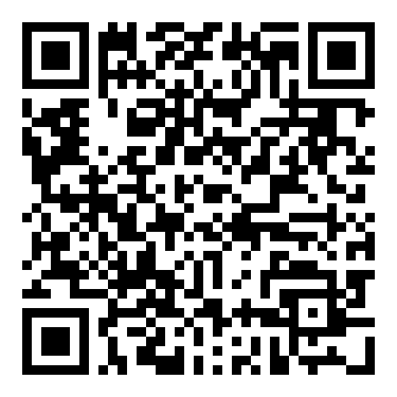
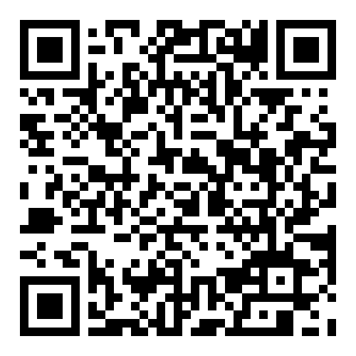
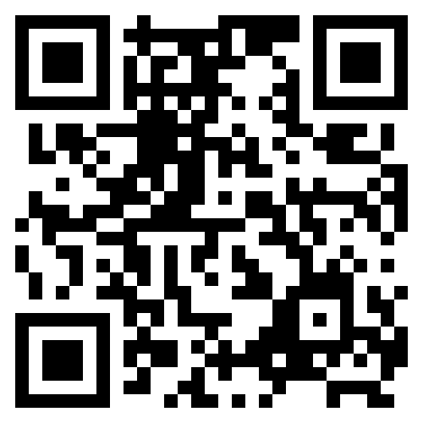
Interesting Artist/tutorials
Elekktronaut
Paketa12
Noto the talking ball
The Interactive Immersive HQ
Derivative fundamentals
Node Institute

Slide 17
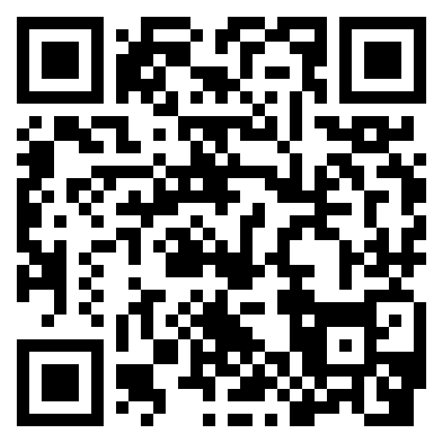
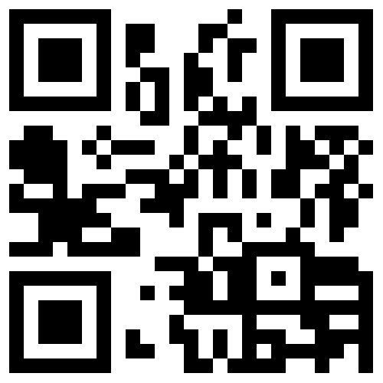
Email_to:
raul.andres.leal@gmail.com
https://www.instagram.com/raul.andres.leal/
https://rauleal.com/

Slide 18
Coming up
Utrecht CCU
  25th April TouchDesigner meetup
Berlin
  22-23 May – European TouchDesigner event- Also online
Amsterdam
  28 May – TouchDesigner meet up (Amaze/y=f(x))
Online
  NODE institute - Summer sessions 2024

Slide 19
Thanks !

